Slide 1
Principal Components Analysis Exploratory Factor Analysis
Chapter 13

Slide 2
What they do…
Both Principle components analysis (PCA) and Exploratory factor analysis (EFA) are used to understand the underlying patterns in the data

Slide 3
What they do…
They group the variables into “factors” or “components” that are the processes that created the high correlations between variables.

Slide 4
Factor analysis
Exploratory factor analysis (EFA) – describe the data and summarize it’s factors
First step with research/data set
Confirmatory factor analysis (CFA) – already know latent factors – therefore, used to confirm relationship between factors and variables used to measure those factors.
Structural equation modeling

Slide 5
What they do…
Mathwise – summarizes patterns of correlations and reduce the correlations of variables into components/factors
Data reduction

Slide 6
What they do…
A popular use for both PCA and EFA is for scale development.
You can determine which questions best measure what you are trying to assess.
That way you can shorten your scale from 100 questions to maybe 15.

Slide 7
What they do…
Regression on crack
Creates linear combinations (regression equations) of the variables > which then is transposed into a component/factor

Slide 8
What they do…
Interpretation – as with clustering/scaling, one main problem with PCA/EFA is the interpretation.
A good analysis is explainable / make sense

Slide 9
Problems
How do you know that this solution is the best solution?
There isn’t quite a good way to know if it’s a good solution like regression
Loads of rotation options

Slide 10
Eeek!
EFA is usually a hot mess
As with every other type of statistical analysis we discuss, EFA has a certain type of research design associated with it.
Not a last resort on messy data.
AND often researchers do not apply the best established rules and therefore end up with results you don’t know what they mean.

Slide 11
Terms to know
Observed correlation matrix – the correlations between all of the variables
Akin to doing a bivariate correlation chart
Reproduced correlation matrix – correlation matrix created from the factors.

Slide 12
Terms to know
Residual correlation matrix – the difference between the original and reduced correlation matrix
You want this to be small for a good fitting model

Slide 13
Terms to Know
Factor rotation – process by which the solution is made “better” (smaller residuals) without changing the mathematical properties.

Slide 14
Terms to Know
Factor rotation – orthogonal – holds all the factors as uncorrelated (!!)
Factor 1
Factor 1
Factor 2
Factor 2

Slide 15
Terms to know
Factor rotation – orthogonal – varimax is the most common
Loading matrix – correlations between the variables and factors
Interpret the loading matrix
But – how many times in life are things uncorrelated?

Slide 16
Terms to know
Factor rotation – oblique – factors are allowed to be correlated when they are rotated
Factor 1
Factor 1
Factor 2
Factor 2

Slide 17
Terms to know
Factor correlation matrix – correlations among the factors
Structure matrix – correlations between factors and variables
Pattern matrix – unique correlation between each factor and variables (no overlap which is allowed with rotation)
Similar to pr
Interpret pattern matrix

Slide 18
Terms to know
Factor rotation – oblique rotations – oblimin, promax
You’ll know what type of rotation you’ve chosen by the output you get…

Slide 19
What’s the differences?
EFA = produces factors
Only the shared variance and unique variance is analyzed
PCA = produces components
All the variance in the variables is analyzed

Slide 20
What’s the difference?
EFA – factors are thought to cause variables, the underlying construct is what creates the scores on each variable
PCA – components are combinations of correlated variables, the variables cause the components

Slide 21
Limitations - Practical
How many variables?
You want several variables or items because if you only include 5, you are limited in the correlations that are possible AND the number of factors
Usually there’s about 10 (that could be expensive if you have to pay for your measures…)

Slide 22
Limitations - Practical
Sample size
The number one complaint about PCA and EFA is the sample size.
It is a make/break point in publications
Arguments abound what’s best.

Slide 23
Limitations - Practical
Sample size
100 is the lowest scrape by amount
200 is generally accepted as ok
300+ is the safest bet

Slide 24
Limitations - Practical
Missing data
PCA/EFA does not do missing data
Estimate the score, or delete it.

Slide 25
Limitations - Practical
Normality – multivariate normality is assumed
Its ok if they aren’t quite normal, but makes it easier to rotate when they are

Slide 26
Limitations - Practical
Linearity – correlations are linear! We expect there to linearity.

Slide 27
Limitations - Practical
Outliers - since this is regression and correlation – then outliers are still bad.
Zscores and mahalanobis

Slide 28
Limitations - Practical
PCA – multicollinearity = no big deal.
EFA – multicollinearity = delete or combine one of the overlapping variables.

Slide 29
Limitations - Practical
Unrelated variables (outlier variables) – only load on one factor – need to be deleted for a rerun of EFA.

Slide 30
Example
Dataset contains a bunch of personality characteristics
PCA – how many components do we expect?
EFA – how many factors do we expect?

Slide 31
PCA
For PCA make sure this screen says “Principle components”
One leading problem with EFA is that people use Principle components math! Eek!
Ask for a scree plot
Pick a number of factors/let it pick**

Slide 32
PCA - boxes
Communalities – how much variance of the variable is accounted for by the components.

Slide 33
PCA - boxes
Eigenvalue box – remember eigenvalues are a mathematical way to rearrange the variance into clusters.
This box tells you how much variance each one of those “clusters”/eigenvalues account for.

Slide 34
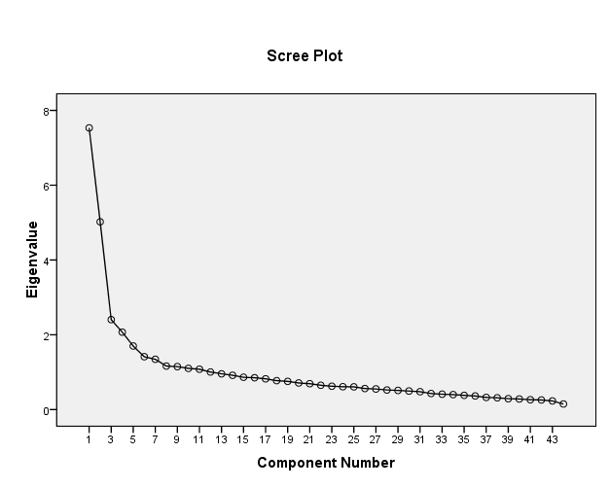
PCA - boxes
Scree plot – plots the eigenvalues

Slide 35
PCA - boxes
Component matrix – the loading of each variable on each component.
You want them to load highly on components
BUT only on one component or it’s all confusing.
What’s high?
.300 is a general rule of thumb

Slide 36
EFA
Choose max likelihood or unweighted least squares

Slide 37
EFA
Varimax – orthogonal rotation
Oblimin – oblique rotation

Slide 38
Best Rules
Oblique vs Orthogonal?
Why why why use orthogonal?
Don’t force things to be uncorrelated when they don’t have to be!
If it’s truly uncorrelated oblique will give you the exact same results as orthogonal.

Slide 39
Best Rules
How many factors?
Scree plot/eigenvalues
Look for the big drop
How much does a bootstrap analysis suggest (aka parallel analysis)?
Don’t just do how many eigenvalues over one (kaiser) all by itself

Slide 40
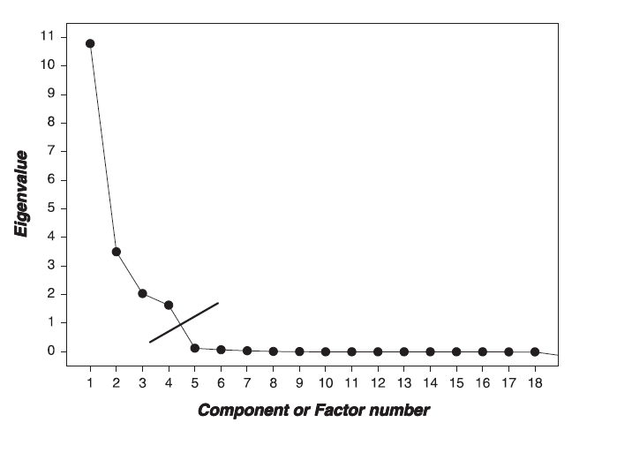

Slide 41
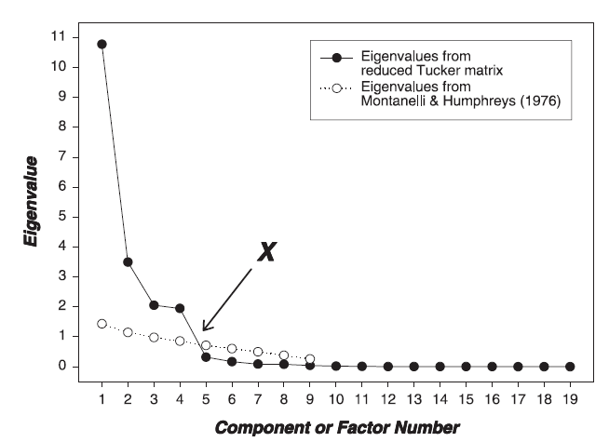

Slide 42
EFA - oblique
Same boxes – then structure and pattern matrix
Interpret pattern matrix.
Loadings higher than .300

Slide 43
Factor!
Free little program that you can do factor analysis with…
Lots more rotation options
Other types of correlation options
Gives you more goodness of fit tests
Since SPSS doesn’t give you any!

Slide 44
Factor
First read the data
You can save the data as space delimited from SPSS
You have to know the number of lines and columns

Slide 45
Factor
Configure – select options you want
Types of correlations
Pearson for normally distributed continuous data sets
Polychloric for dichotomous data sets

Slide 46
Factor
Parallel analysis or parallel bootstraps makes rotation easiest and quickest
Also crashes less
Number of factors
ULS/ML = EFA
PCA = PCA

Slide 47
Factor
Rotations – you got a LOT of options. Good luck.
Compute!

Slide 48
What’s different output?
GOODNESS OF FIT STATISTICS
Chi-Square with 64 degrees of freedom = 92.501 (P = 0.011421)
Chi-Square for independence model with 91 degrees of freedom = 776.271
Non-Normed Fit Index (NNFI; Tucker & Lewis) = 0.94
Comparative Fit Index (CFI) = 0.96
Goodness of Fit Index (GFI) = 0.99
Adjusted Goodness of Fit Index (AGFI) = 0.98
Want these to be high!
Root Mean Square of Residuals (RMSR) = 0.0451
Expected mean value of RMSR for an acceptable model = 0.0600 (Kelly's criterion)
Want these to be low!

Slide 49
The best of the best
Preacher and MacCallum (2003)
Repairing Tom Swift’s Factor Analysis Machine
If you want to do EFA the right way, quote these people.

